Slide 1
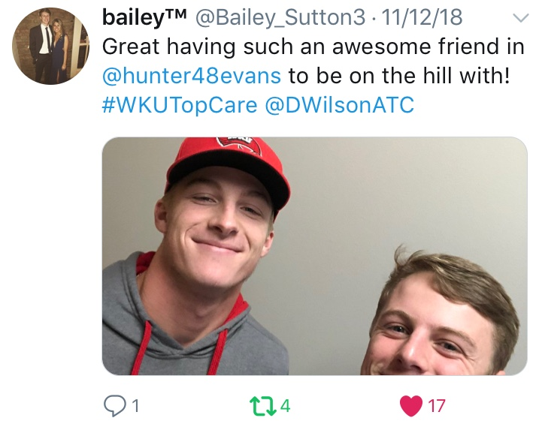
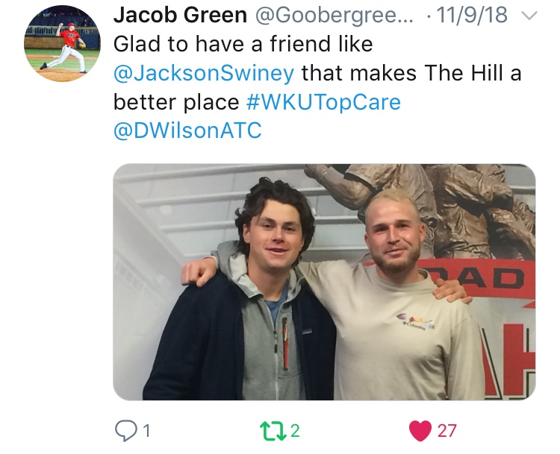
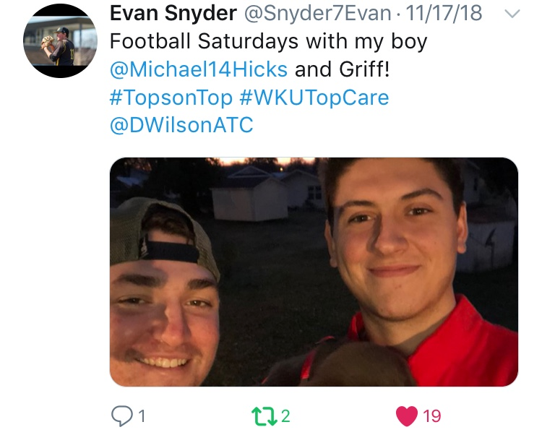
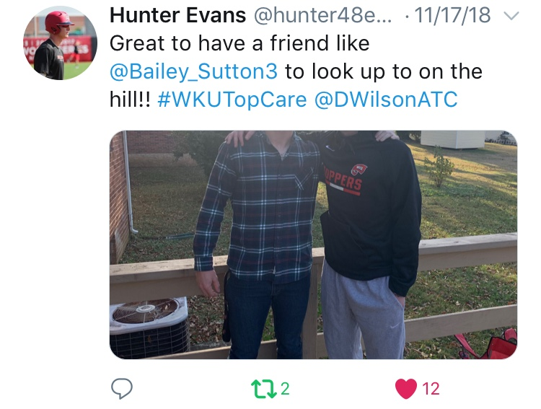
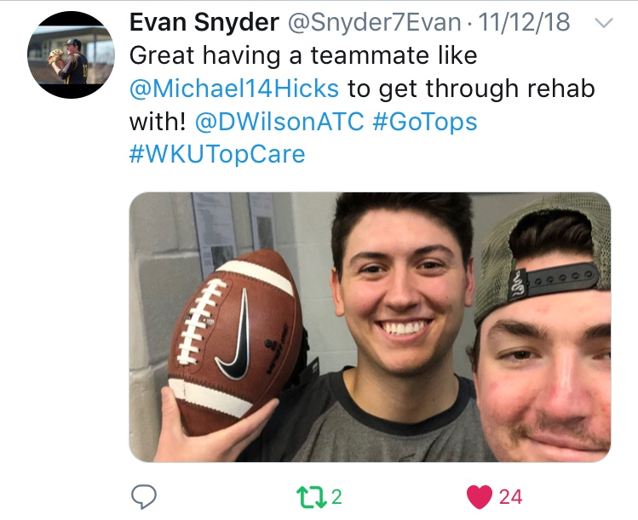
Participant | Followers
Jacob Green | 776
Jackson Swiney | 104
Hunter Evans | 307
Bailey Sutton | 1209
Evan Snyder | 452
Michael Hicks | 484
Potential Views | 3,332

